Slide 1
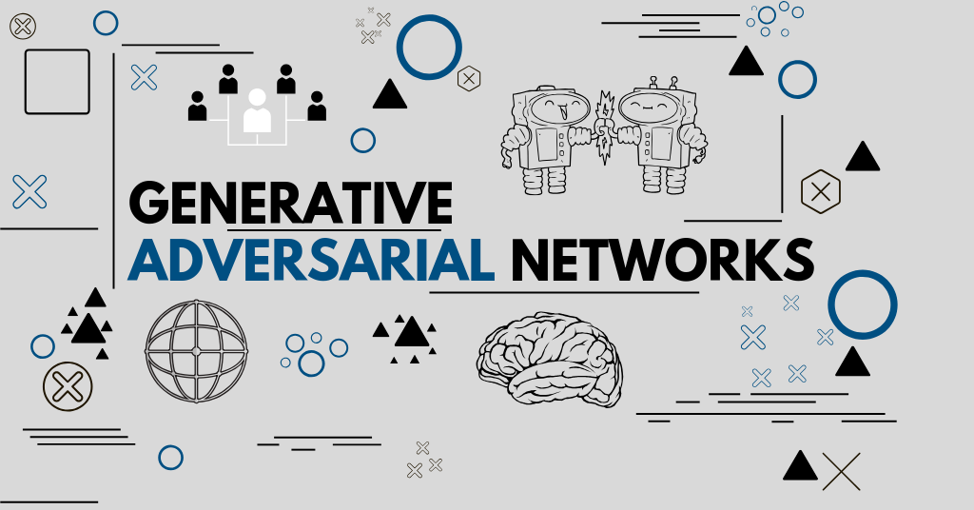
GAN and Generative Models
2020.12.18

Slide 2
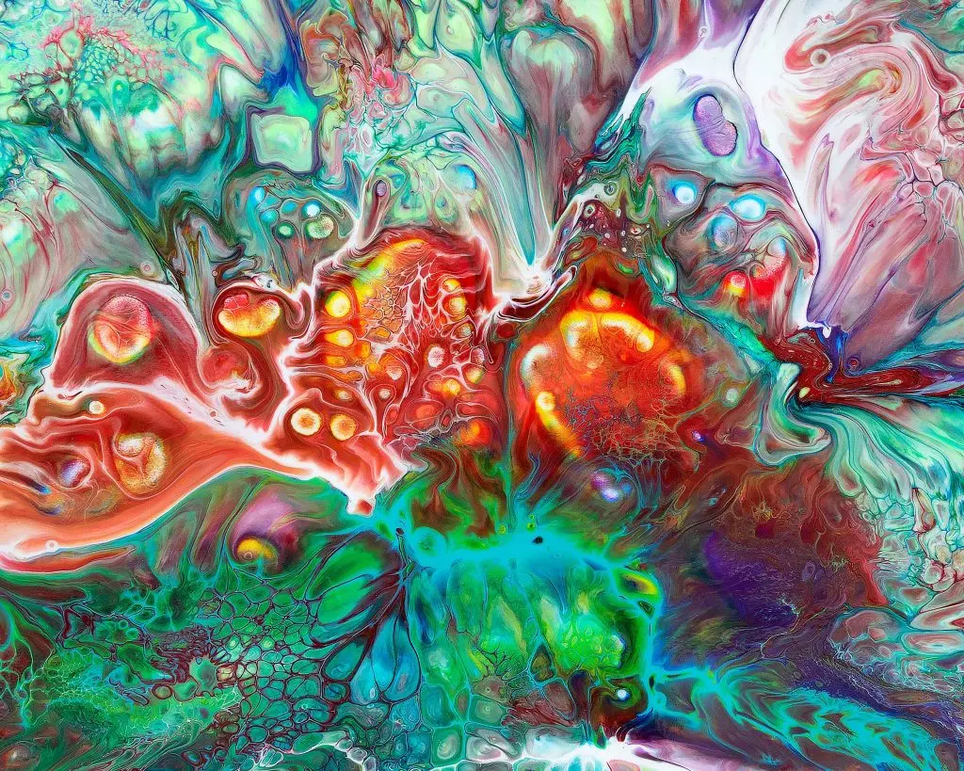
Outline
The Concept of GANs
Learning Representation with GANs
More Applications of GANs
Some Other Competitive Design of Models
More on Generative Models

Slide 3
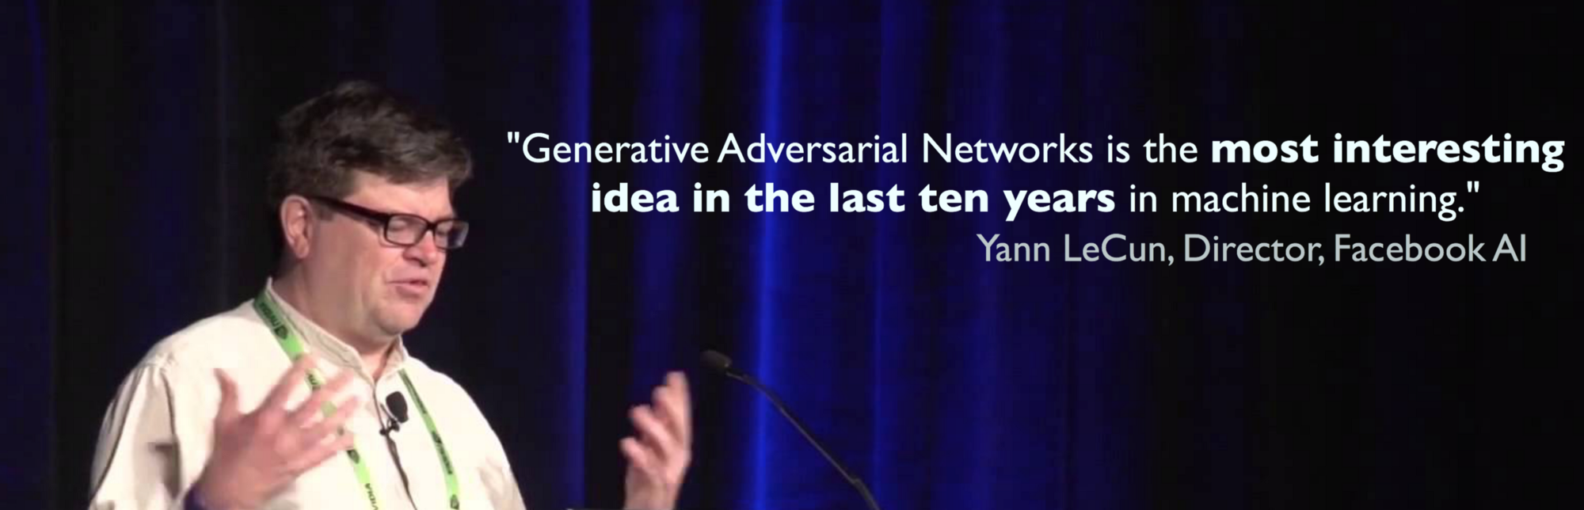
Generative Adversarial Networks
Goodfellow, Ian; Pouget-Abadie, Jean; Mirza, Mehdi; Xu, Bing; Warde-Farley, David; Ozair, Sherjil; Courville, Aaron; Bengio, Yoshua (2014). Generative Adversarial Networks. Proceedings of the International Conference on Neural Information Processing Systems (NIPS 2014). pp. 2672–2680.

Slide 4
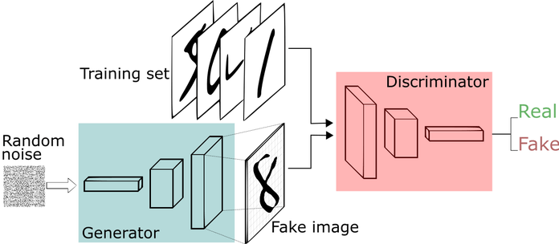
GAN: Concept
Two learning models compete to each other

Slide 5
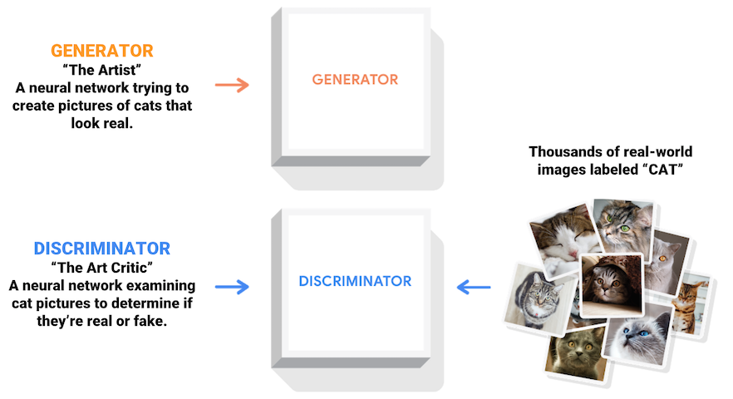
GAN: Artist vs Critics

Slide 6
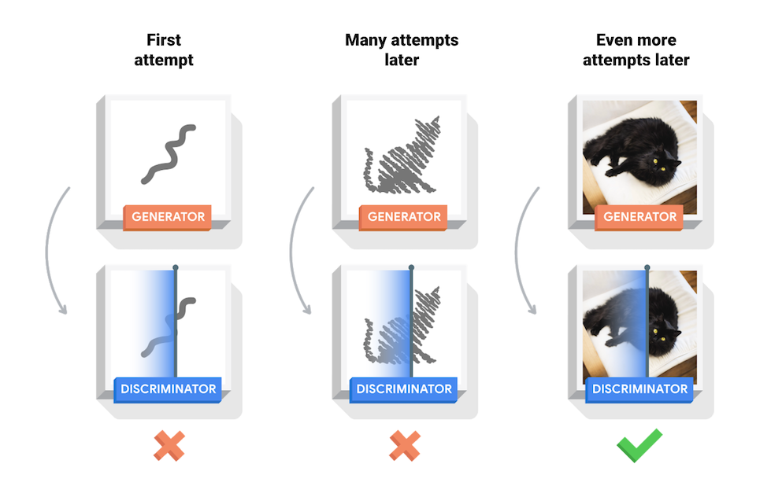
GAN: The Learning Process

Slide 7
GAN: The Algorithm

Slide 8
GAN: Generated Examples
Rightmost column shows the nearest training example of
the neighboring sample, in order to demonstrate that the model has not memorized the training set.

Slide 9
GAN: in the Original Paper
A clearly described algorithm and theorem
A derivation of (theoretical) global optimality
A proof of convergence of the algorithm
Well designed experiments
Comparison with other generative models
Goodfellow, Ian; Pouget-Abadie, Jean; Mirza, Mehdi; Xu, Bing; Warde-Farley, David; Ozair, Sherjil; Courville, Aaron; Bengio, Yoshua (2014). Generative Adversarial Networks. Proceedings of the International Conference on Neural Information Processing Systems (NIPS 2014). pp. 2672–2680.

Slide 10
GAN: Representation Learning
Deep Convolutional Generative Adversarial Networks (DCGANs, Radford, et al., 2016)
Radford, A., Metz, L., & Chintala, S. (2016). Unsupervised Representation Learning with Deep Convolutional Generative Adversarial Networks. ArXiv:1511.06434 [Cs]. http://arxiv.org/abs/1511.06434

Slide 11
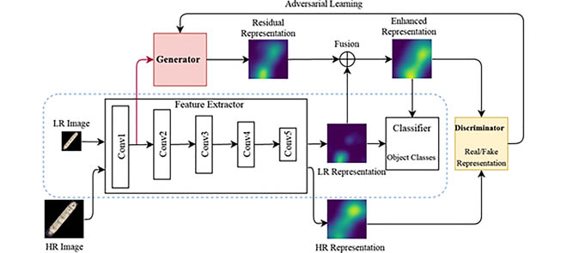
GAN: Representation Learning
Identifying tiny objects with extremely low resolution
Xi, Y., Zheng, J., Jia, W., He, X., Li, H., Ren, Z., & Lam, K. (2020). See Clearly in the Distance: Representation Learning GAN for Low Resolution Object Recognition. IEEE Access, 8, 53203–53214. https://doi.org/10.1109/ACCESS.2020.2978980

Slide 12
GAN: Representation Learning
BSD-GAN: Branched Generative Adversarial Network for Scale-Disentangled Representation Learning
Yi, Z., Chen, Z., Cai, H., Mao, W., Gong, M., & Zhang, H. (2020). BSD-GAN: Branched Generative Adversarial Network for Scale-Disentangled Representation Learning and Image Synthesis. ArXiv:1803.08467 [Cs]. http://arxiv.org/abs/1803.08467

Slide 13
GAN: Other Applications
Generate Examples for Image Datasets
Generate Human Faces
Generate Realistic Photographs
Generate Cartoon Characters
Image-to-Image Translation
Text-to-Image Translation
Semantic-Image-to-Photo Translation
Face Frontal View Generation
Generate New Human Poses
Photos to Emojis
Photograph Editing
Face Aging
Photo Blending
Super Resolution
Photo Inpainting
Clothing Translation
Video Prediction
3D Object Generation
18 Impressive Applications of Generative Adversarial Networks (GANs)

Slide 14
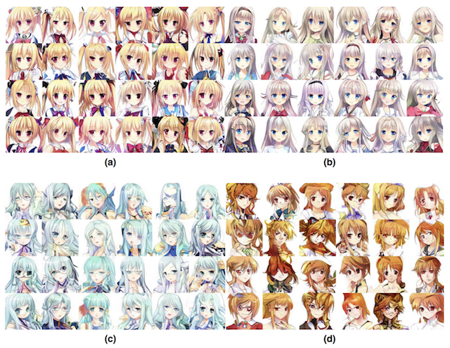
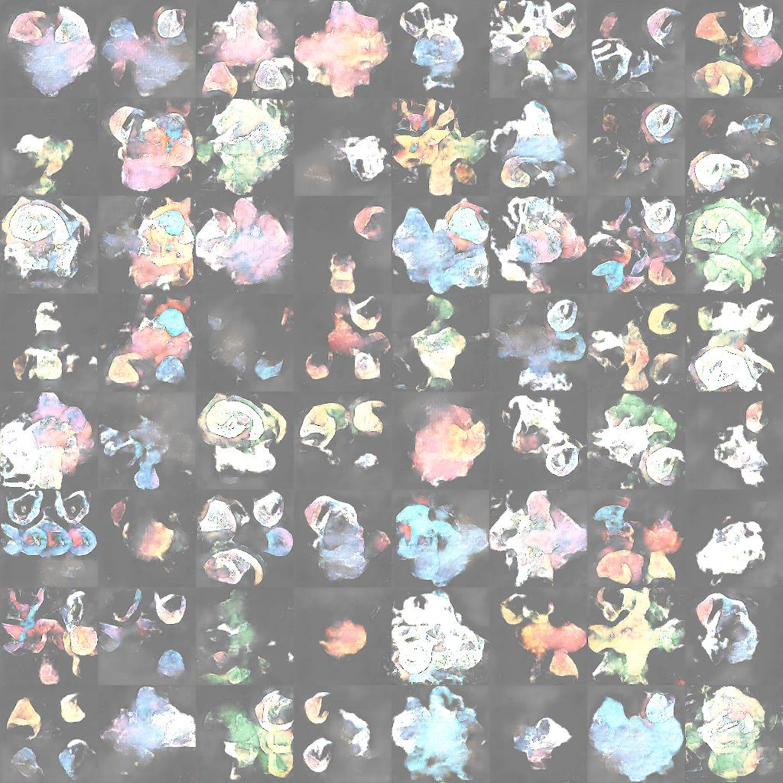
GAN: Other Applications
Generate Cartoon Characters
Yanghua Jin, et al., 2017 “Towards the Automatic Anime Characters Creation with Generative Adversarial Networks”
pokeGAN project and the Generate Pokemon with DCGAN project

Slide 15
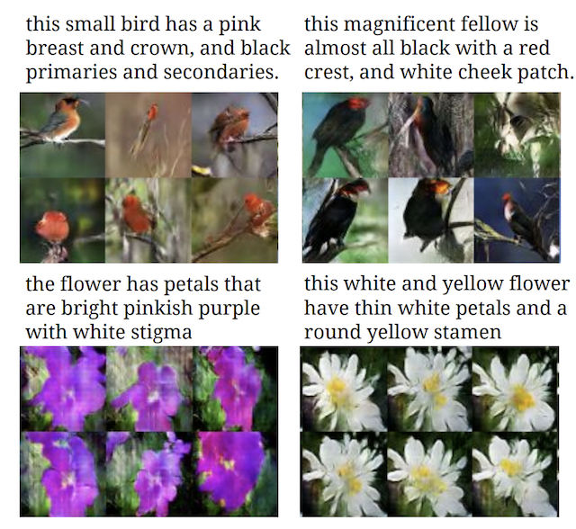
GAN: Other Applications
Text-to-Image Translation (text2image)
Han Zhang, et al. in their 2016 paper titled “StackGAN: Text to Photo-realistic Image Synthesis with Stacked Generative Adversarial Networks”
Scott Reed, et al. in their 2016 paper titled “Generative Adversarial Text to Image Synthesis”
Ayushman Dash, et al. provide more examples on seemingly the same dataset in their 2017 paper titled “TAC-GAN – Text Conditioned Auxiliary Classifier Generative Adversarial Network“

Slide 16
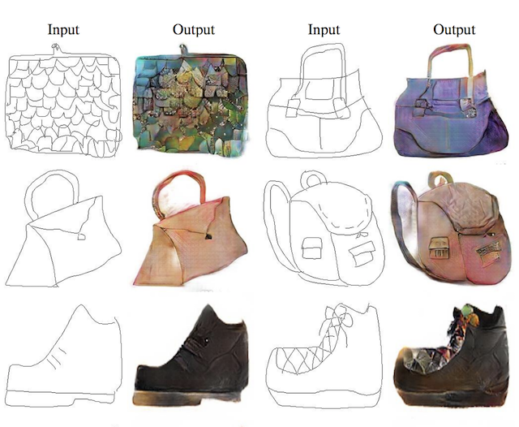
GAN: Other Applications
Image-to-Image Translation
Example of Sketches to Color Photographs With pix2pix.Taken from Image-to-Image Translation with Conditional Adversarial Networks, 2016.

Slide 17
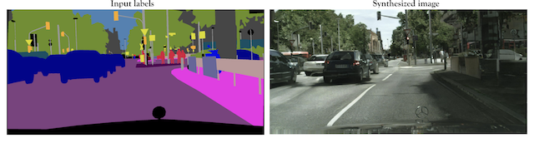
GAN: Other Applications
Semantic-Image-to-Photo Translation
Ting-Chun Wang, et al. in their 2017 paper titled “High-Resolution Image Synthesis and Semantic Manipulation with Conditional GANs” demonstrate the use of conditional GANs to generate photorealistic images given a semantic image or sketch as input.

Slide 18
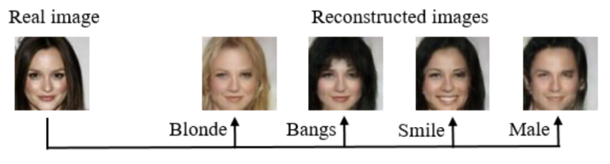
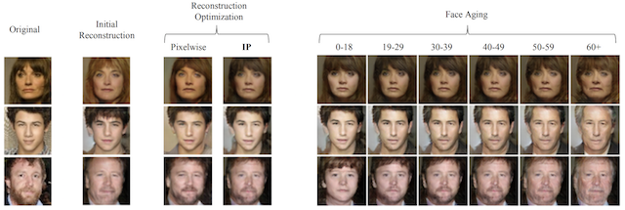
GAN: Other Applications
Photograph Editing
Guim Perarnau, et al. in their 2016 paper titled “Invertible Conditional GANs For Image Editing”
Grigory Antipov, et al. in their 2017 paper titled “Face Aging With Conditional Generative Adversarial Networks”

Slide 19
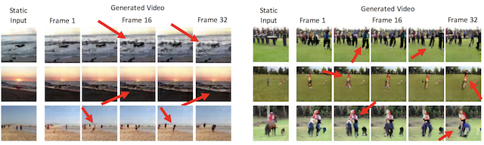

GAN: Other Applications
Video Prediction
Carl Vondrick, et al. in their 2016 paper titled “Generating Videos with Scene Dynamics” describe the use of GANs for video prediction, specifically predicting up to a second of video frames with success, mainly for static elements of the scene.
https://en.wikipedia.org/wiki/Paycheck_(film)

Slide 20
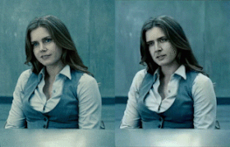

GAN: Other Applications
Deep Fake
https://en.wikipedia.org/wiki/Deepfake

Slide 21
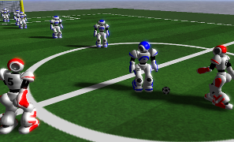
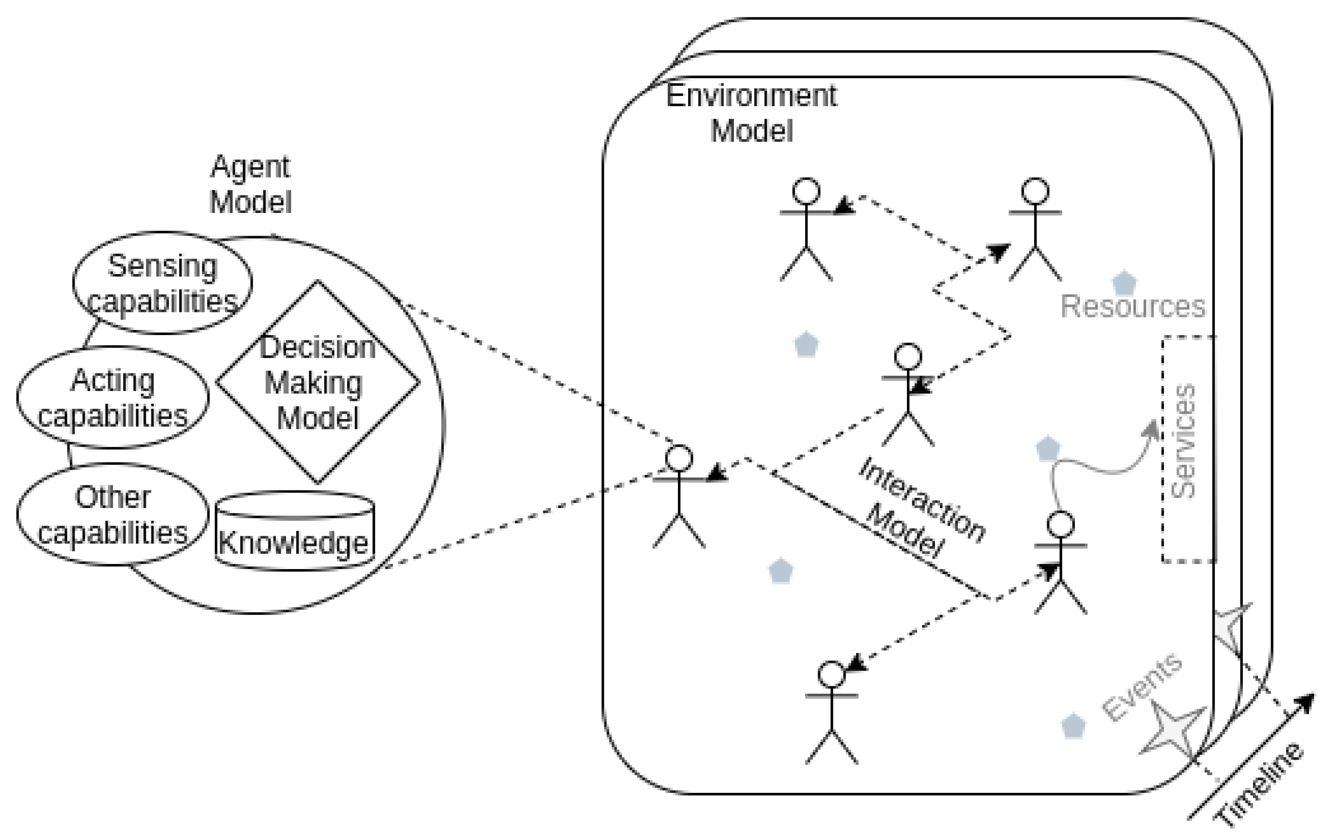
Model Competition: Multiagent System
A multi-agent system (MAS or "self-organized system") is a computerized system composed of multiple interacting intelligent agents.
Multi-agent systems can solve problems that are difficult or impossible for an individual agent or a monolithic system to solve.
Intelligence may include methodic, functional, procedural approaches, algorithmic search or reinforcement learning.
Game theory
Complex systems
Social simulation
Evolutionary computation
Swarm intelligence

Slide 22
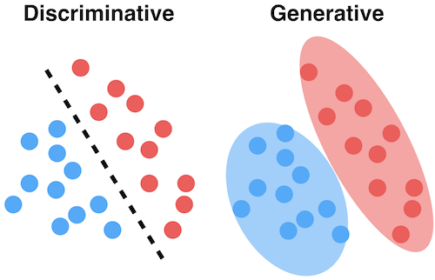
Generative vs. Discriminative Models
Generative models are models where the focus is the distribution of individual classes in a dataset and the learning algorithms tend to model the underlying patterns/distribution of the data points.
These models use the intuition of joint probability in theory, creating instances where a given feature (x)/input and the desired output/label (y) exist at the same time.
Image Source: https://dataisutopia.com/blog/discremenet-generative-models

Slide 23
Generative Models
Generative models use probability estimates and likelihood to model data points and distinguish between different class labels in a dataset. These models are capable of generating new data instances.
Examples of machine learning generative models
Naive Bayes
Hidden Markov model
Linear discriminant analysis (LDA)
Image Source: https://dataisutopia.com/blog/discremenet-generative-models

Slide 24
Discriminative Models
Discriminative models, also called conditional models, tend to learn the boundary between classes/labels in a dataset. Unlike generative models, the goal here is to find the decision boundary separating one class from another.
Examples of discriminative models:
Logistic regression
Support vector machine
Decision tree
Image Source: https://dataisutopia.com/blog/discremenet-generative-models

Slide 25
Back to Representation Learning
A short history
Dimension reduction for pattern recognition
To learn the manifold of the data itself
Abstract, task-invariant characteristics of data
The ultimate question: what is a representation?
Goal-oriented: whatever that can improve the performance of classification/regression.
Something both data-driven and explainable by theories
Calculus in abstract vector space

Slide 26
